Slide 1
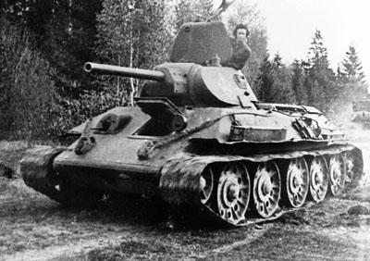
Medium Tank – T34 – Soviet
Statistics
HP -------------------------------------------------------------- 3
AP -------------------------------------------------------------- 1
Damage -------------------------------------------------- 2 – 4
EDR ----------------------------------------------------- 6 units
Max Range ------------------------------------------ 10 units
Commander Points ---------------------------------------- 4
Description
This is a very versatile unit that is most effective in groups. Overall damage output is weak, and the armor is weak to heavier tanks, but a few of these tanks can quickly overwhelm a tougher opponent.

Slide 2
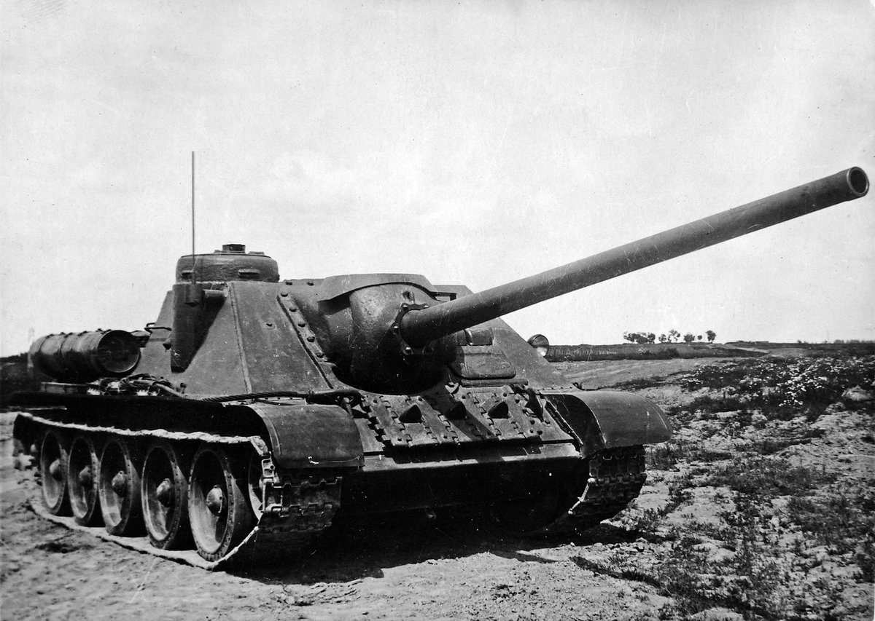
Tank Destroyer – SU-100 – Soviet
Statistics
HP -------------------------------------------------------------- 2
AP -------------------------------------------------------------- 2
Damage -------------------------------------------------- 3 – 5
EDR ---------------------------------------------------- 15 units
Max Range ------------------------------------------ 20 units
Commander Points ---------------------------------------- 3
Description
This tank specializes in long range engagements and has weak armor against heavier opponents. Try flanking with this tank and capturing key overlook positions.

Slide 3
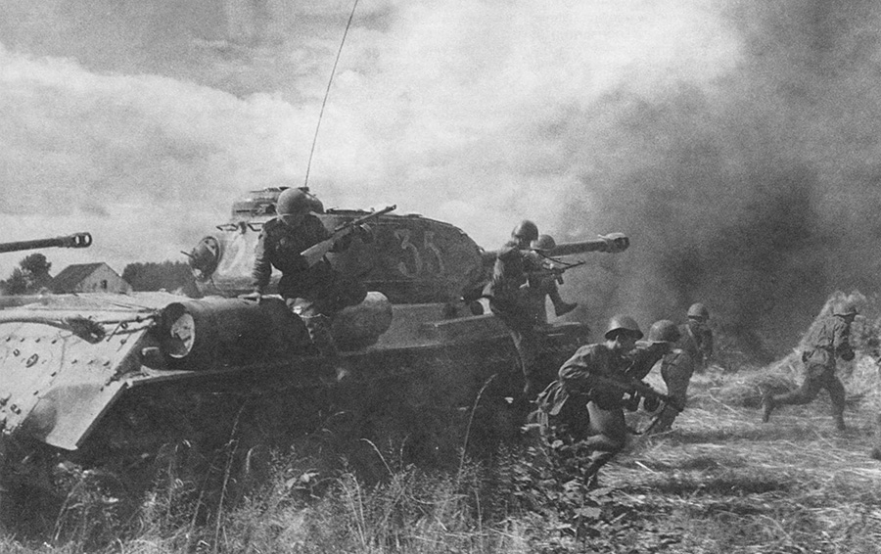
Heavy Tank – IS-2 – Soviet
Statistics
HP -------------------------------------------------------------- 5
AP -------------------------------------------------------------- 2
Damage -------------------------------------------------- 3 – 5
EDR ---------------------------------------------------- 10 units
Max Range ------------------------------------------ 15 units
Commander Points ---------------------------------------- 3
Description
This is a heavy brawler tank that can take quite a bit of damage before going down. Its hard punching gun and high HP makes it a tough nut to crack, but be wary of smaller tanks swarming and overwhelming you.

Slide 4
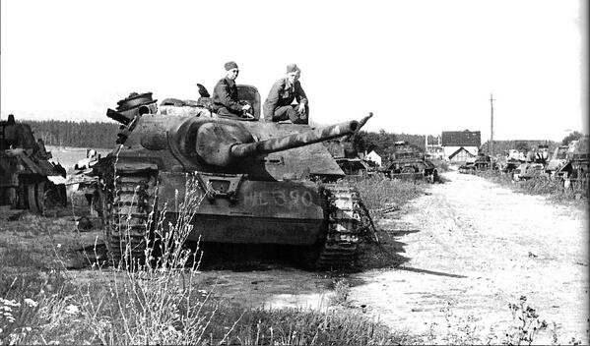
Tank Destroyer – Jagdpanzer IV - German
Statistics
HP -------------------------------------------------------------- 2
AP -------------------------------------------------------------- 2
Damage -------------------------------------------------- 3 – 5
EDR ---------------------------------------------------- 15 units
Max Range ------------------------------------------ 20 units
Commander Points ---------------------------------------- 3
Description
This tank specializes in long range engagements and has weak armor against heavier opponents. Try flanking with this tank and capturing key overlook positions.

Slide 5
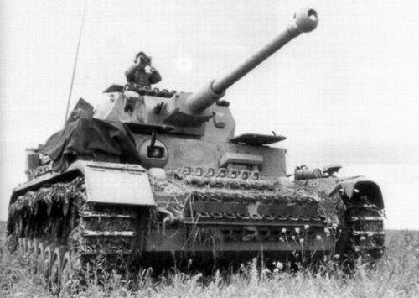
Medium Tank – Panzer IV – German
Statistics
HP -------------------------------------------------------------- 3
AP -------------------------------------------------------------- 1
Damage -------------------------------------------------- 2 – 4
EDR ----------------------------------------------------- 6 units
Max Range ------------------------------------------ 10 units
Commander Points ---------------------------------------- 4
Description
This is a very versatile unit that is most effective in groups. Overall damage output is weak, and the armor is weak to heavier tanks, but a few of these tanks can quickly overwhelm a tougher opponent.

Slide 6
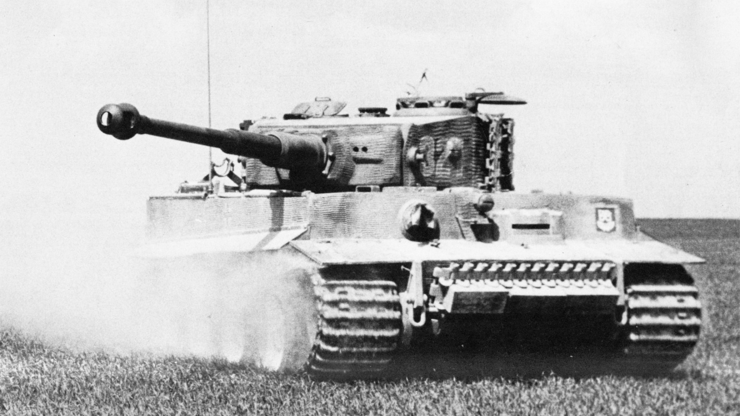
Heavy Tank – Tiger E – German
Statistics
HP -------------------------------------------------------------- 5
AP -------------------------------------------------------------- 2
Damage -------------------------------------------------- 3 – 5
EDR ---------------------------------------------------- 10 units
Max Range ------------------------------------------ 15 units
Commander Points ---------------------------------------- 3
Description
This is a heavy brawler tank that can take quite a bit of damage before going down. Its hard punching gun and high HP makes it a tough nut to crack, but be wary of smaller tanks swarming and overwhelming you.

